Slide 1
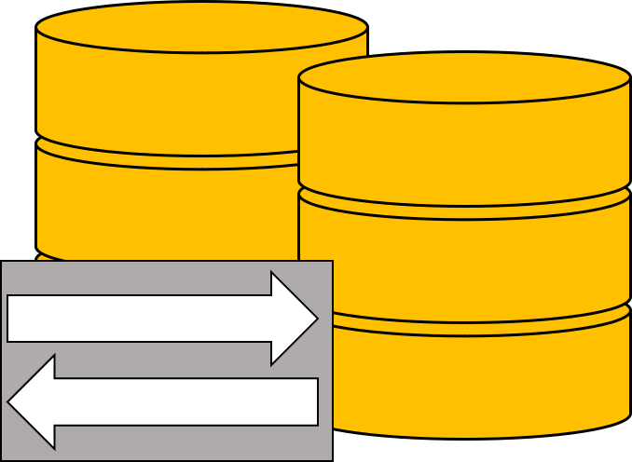
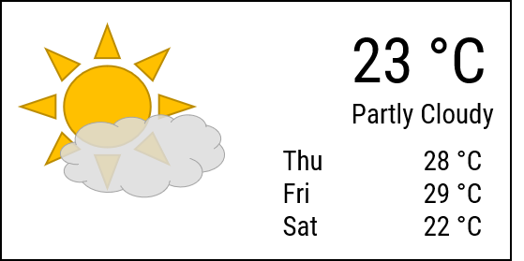
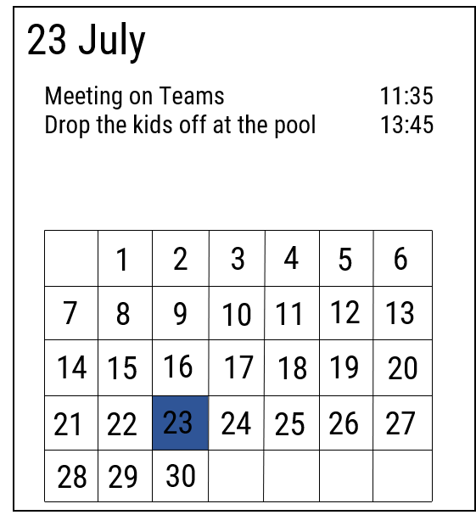
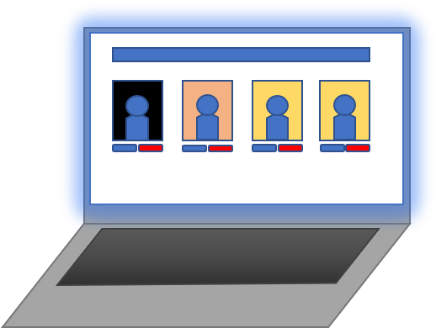

Database and Webserver
Responses
Requests
HTTP
HTTP
Requests
Responses
Registration and Management website
Smart Mirror

Slide 2
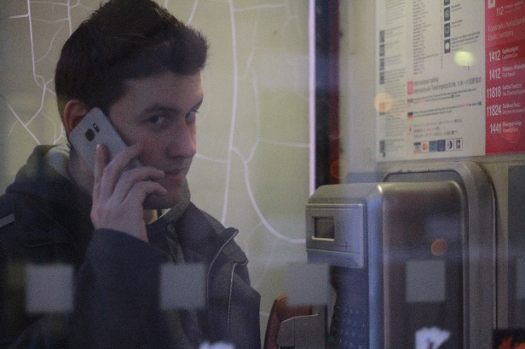
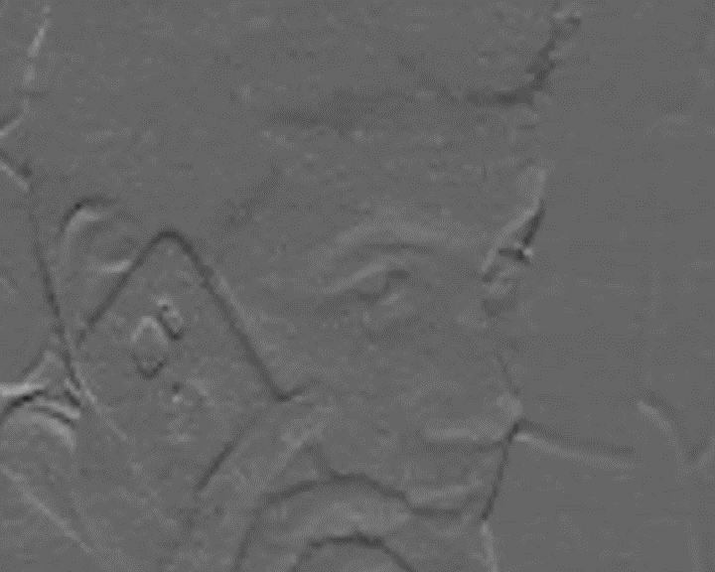
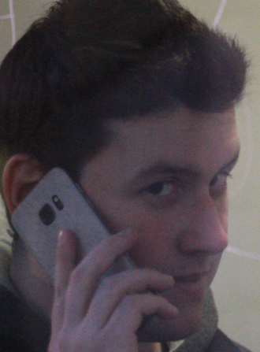
Image Input
Cascade
Feature detect.
Haar Cascade
Input
Output
Crop
Multi-Task CNN
Detection

Slide 3
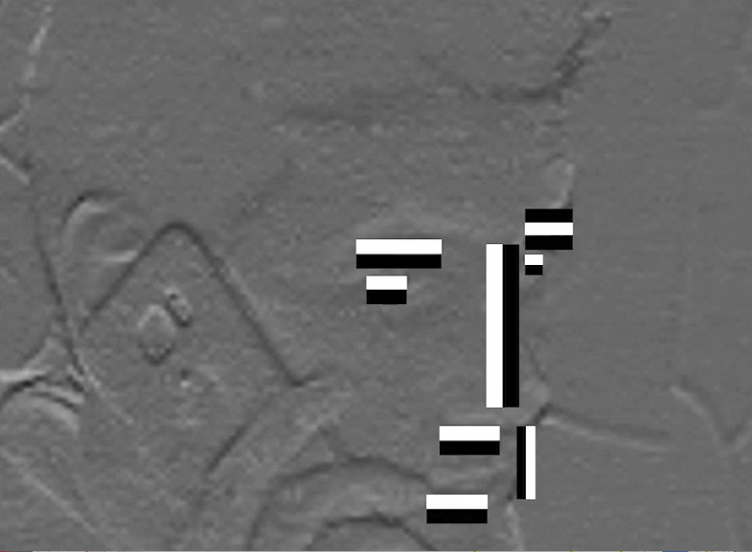
Image Input
Cascade
Feature detect.
Haar Cascade
Input
Output
Crop
Multi-Task CNN
Detection

Slide 4
Input
Output
128D
FaceNet-based CNN
Input
Output
512D
FaceNet-based CNN
Recognition

Slide 5
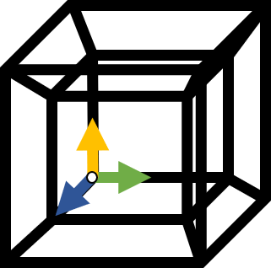
Input
Output
128D
FaceNet-based CNN
Input
Output
512D
FaceNet-based CNN
Representation

Slide 6
Input
Output
128D
FaceNet-based CNN
Input
Output
512D
FaceNet-based CNN
Representation

Slide 7
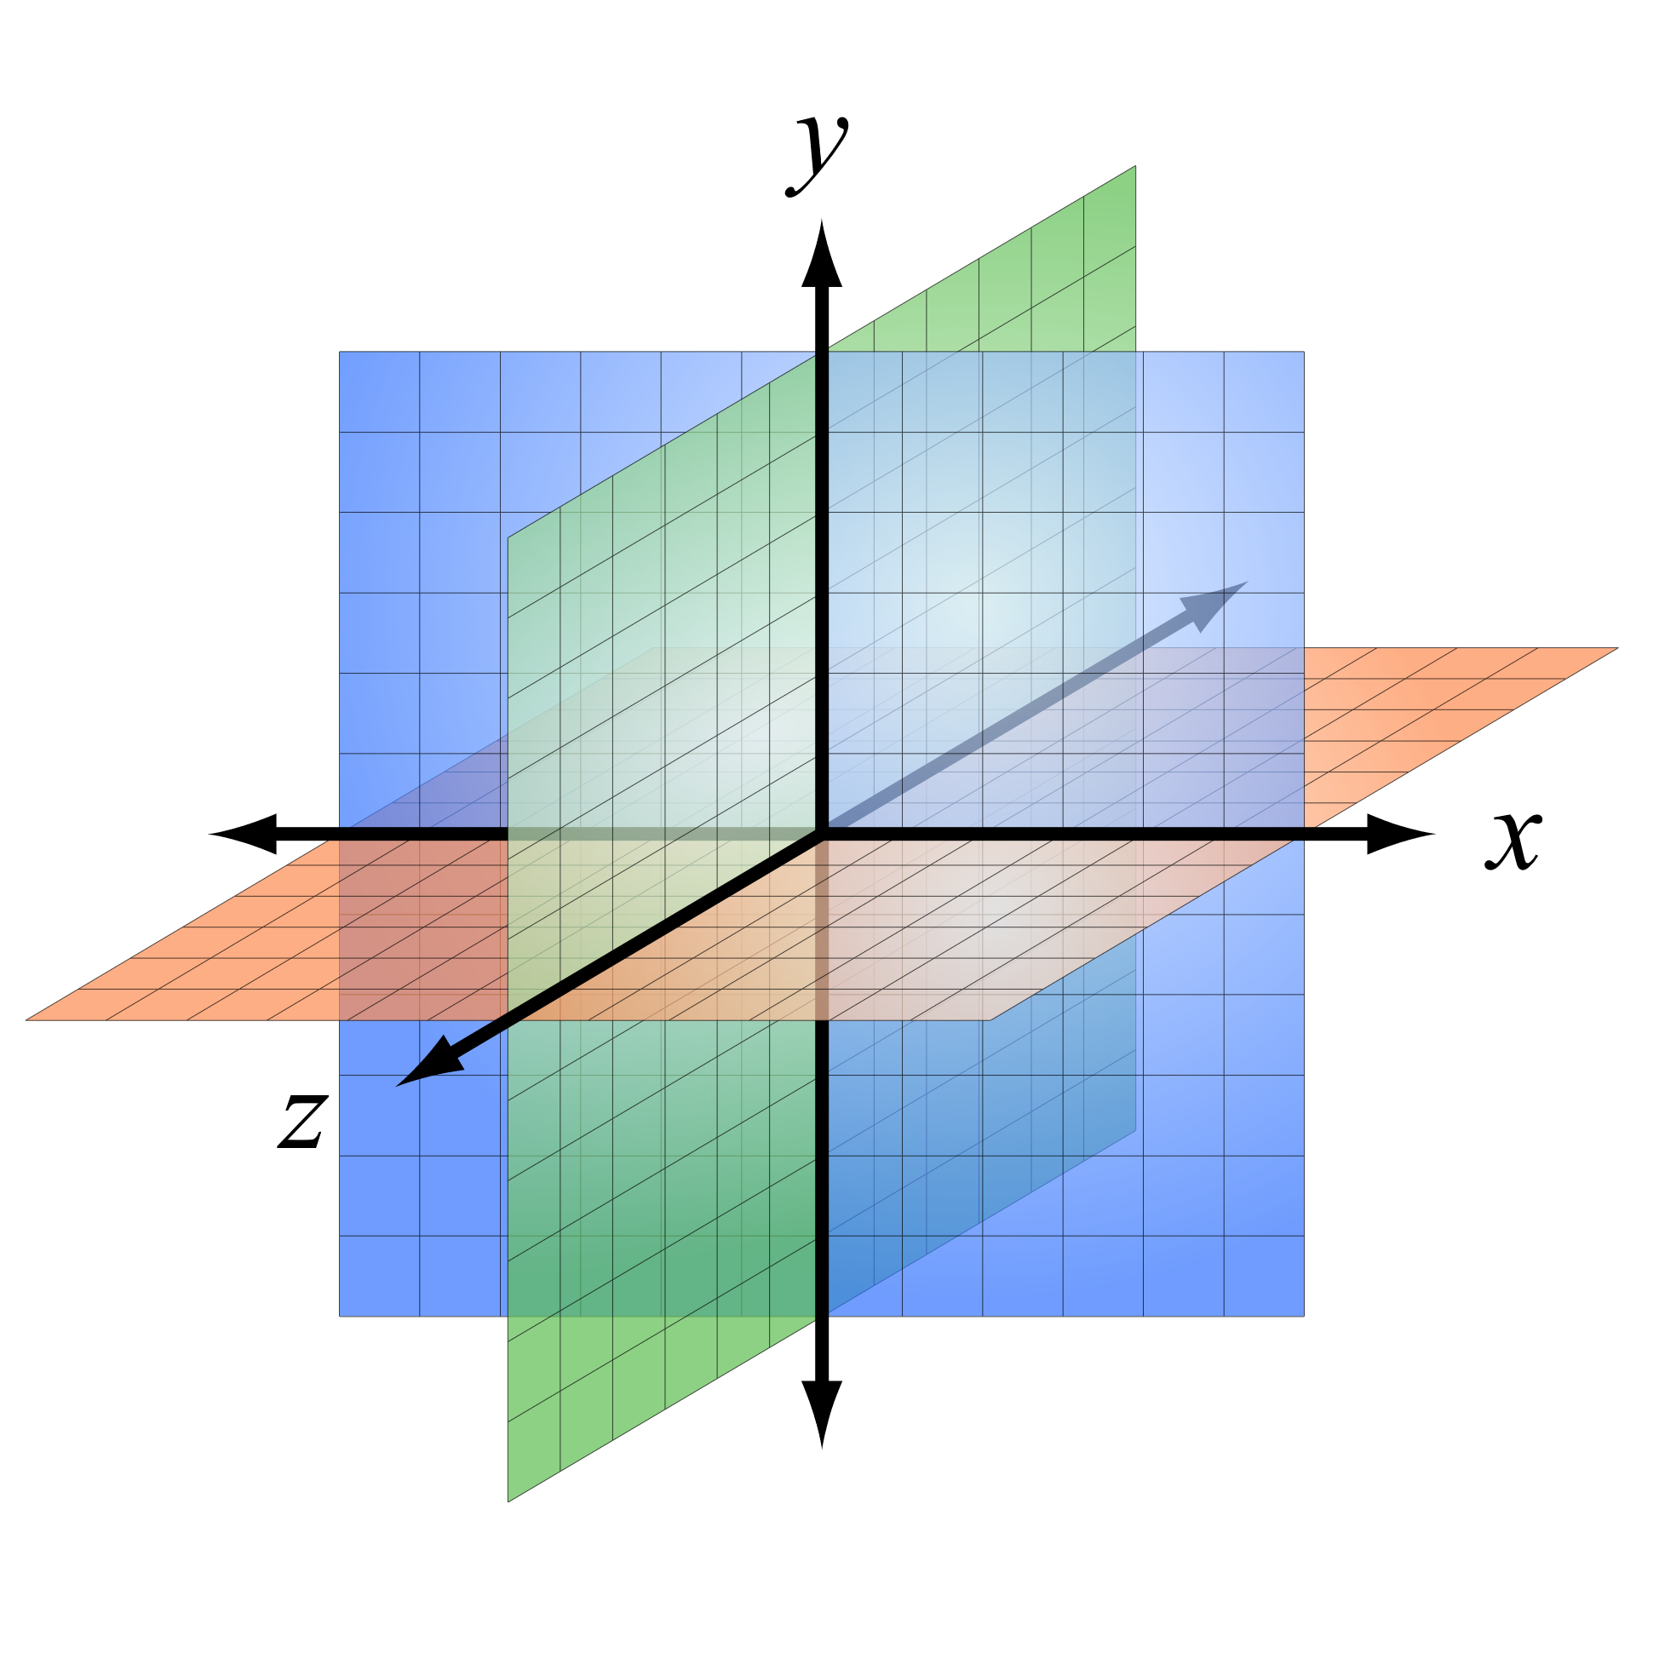
128D
512D
Support Vector Machine
Label
Distance
Subject
Minimum Distance Selection
Classification

Slide 8



Slide 9
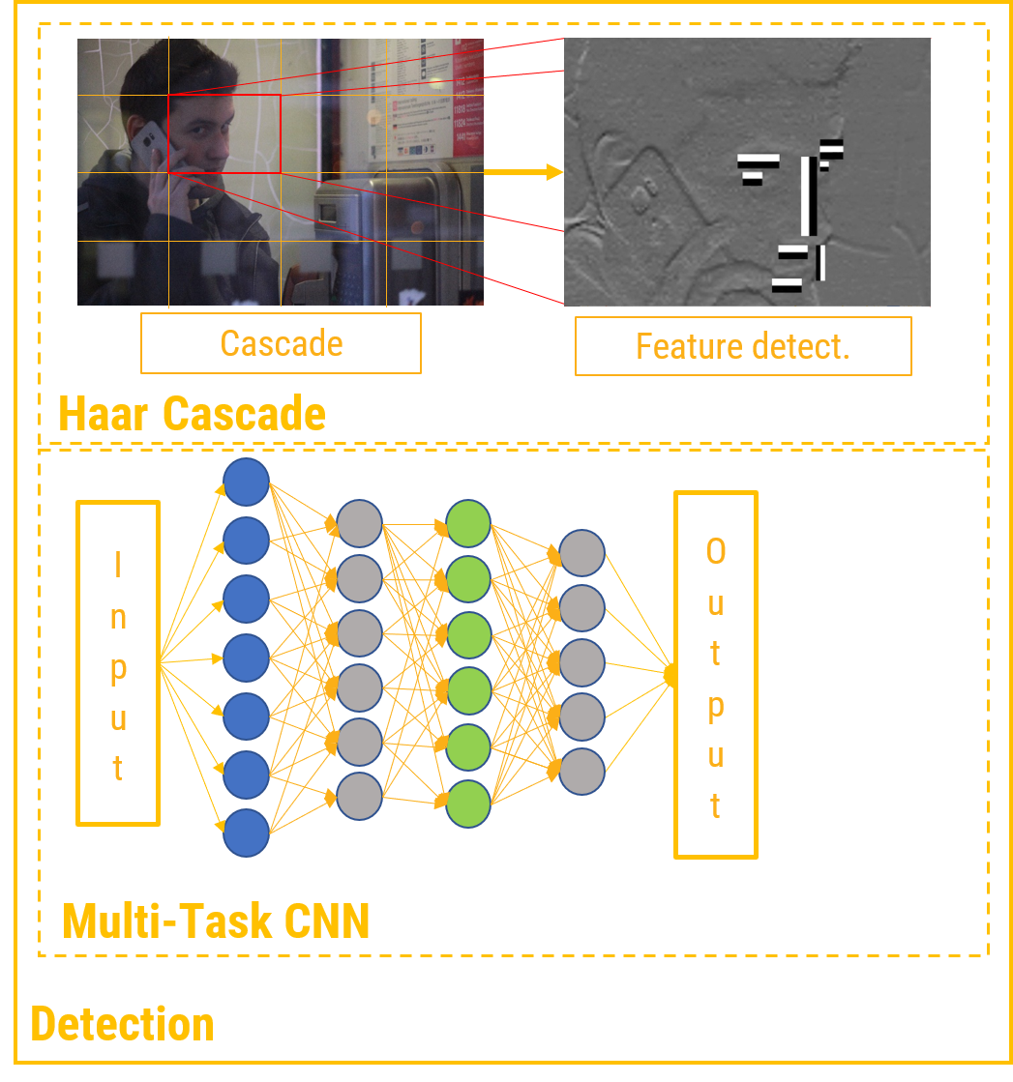
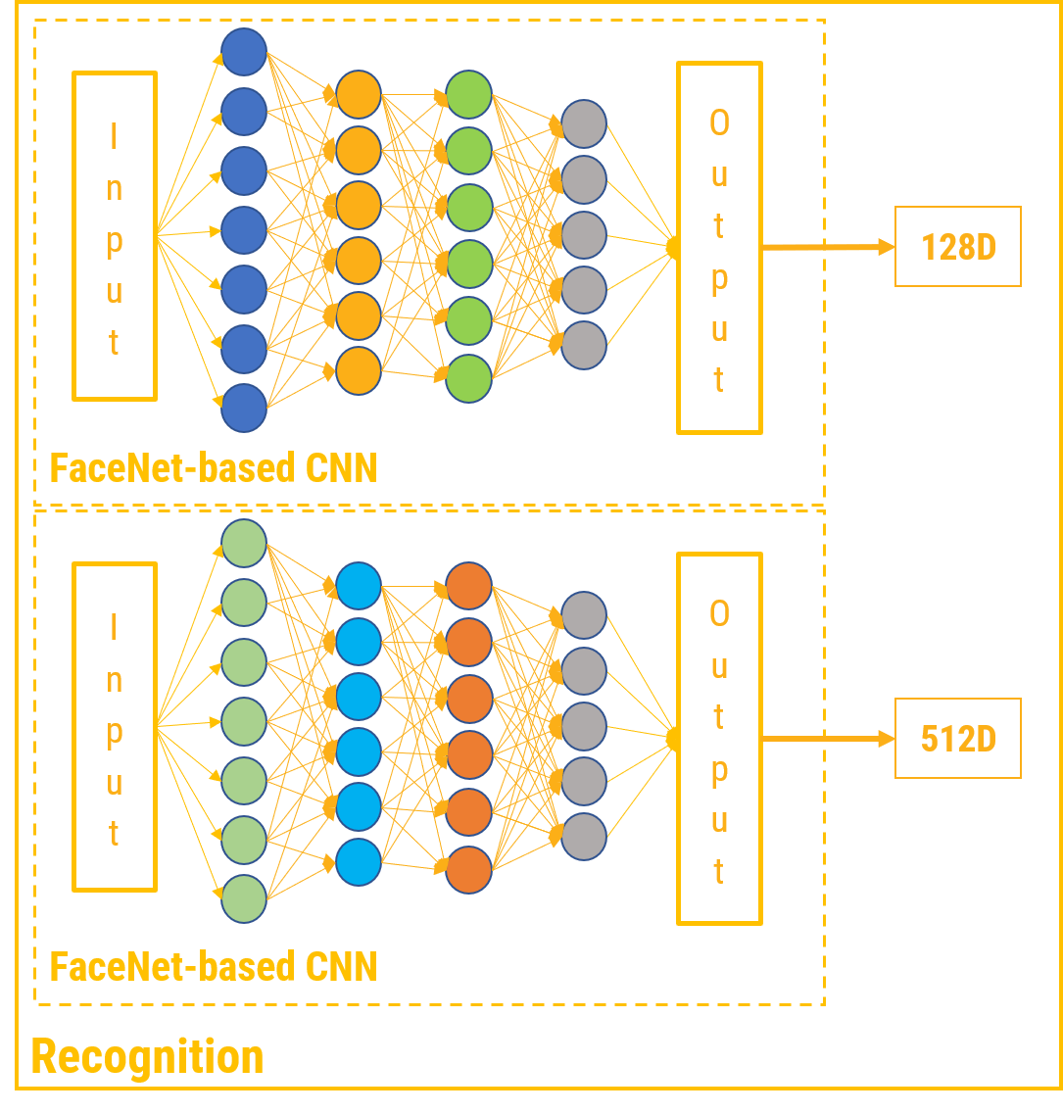
Image Input
Notes:
Here, you can see the overview of our facial recognition pipeline.
We capture an image from the camera and we run a simple object detection algorithm called Haar Cascade to determine the smallest rectangle that contains the face itself.
Haar Cascade uses a pre-defined feature set for object recognition. It tries to match features on the input image to this set as shown.
We crop the frame to this rectangle

Slide 10


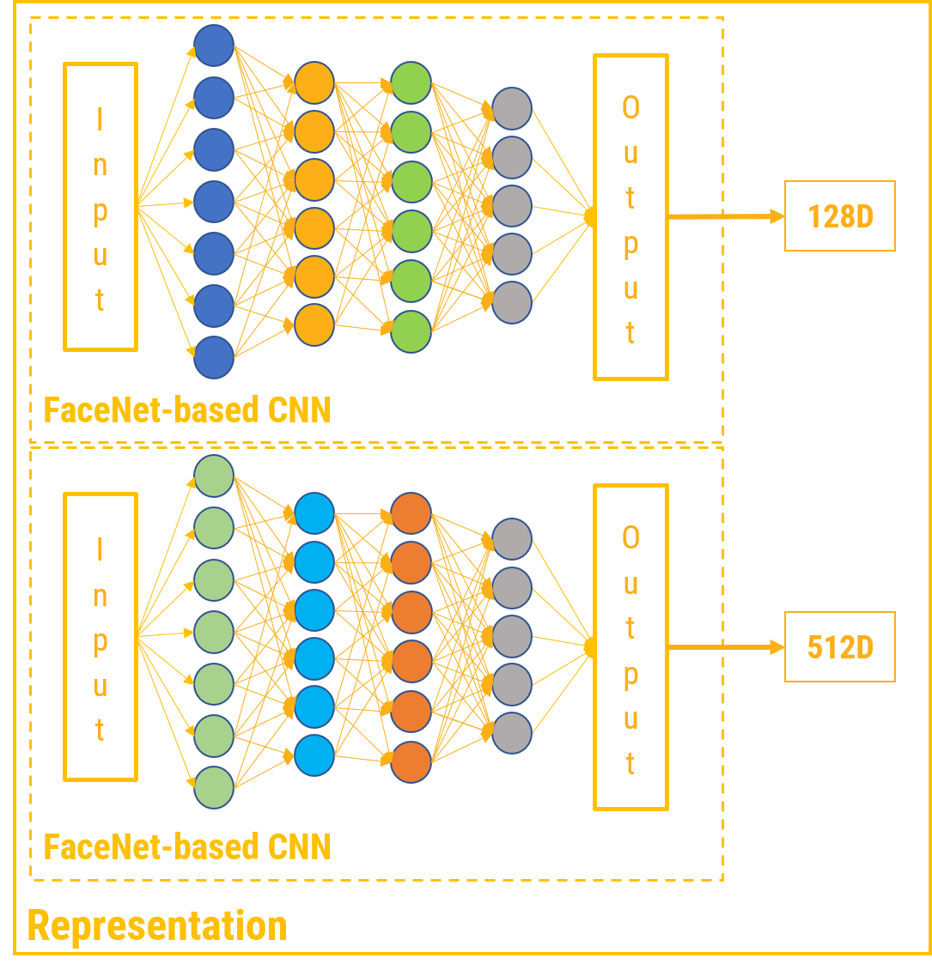
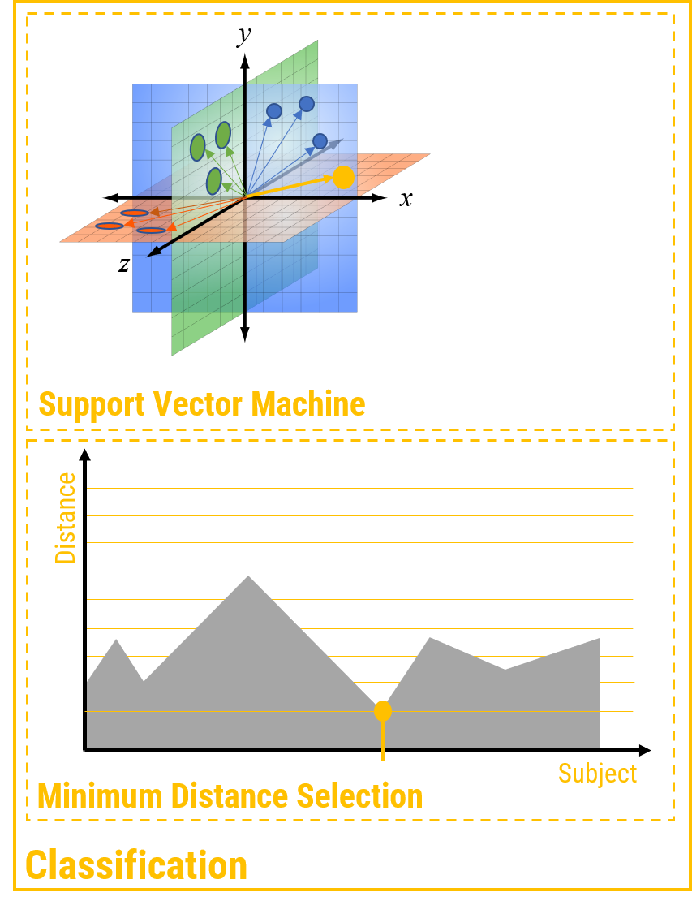
Face Recognition Pipeline
Image Input
User Lookup
Notes:
Here, you can see the overview of our facial recognition pipeline.
We capture an image from the camera and we run a simple object detection algorithm called Haar Cascade to determine the smallest rectangle that contains the face itself.
Haar Cascade uses a pre-defined feature set for object recognition. It tries to match features on the input image to this set as shown.
We crop the frame to this rectangle

Slide 11
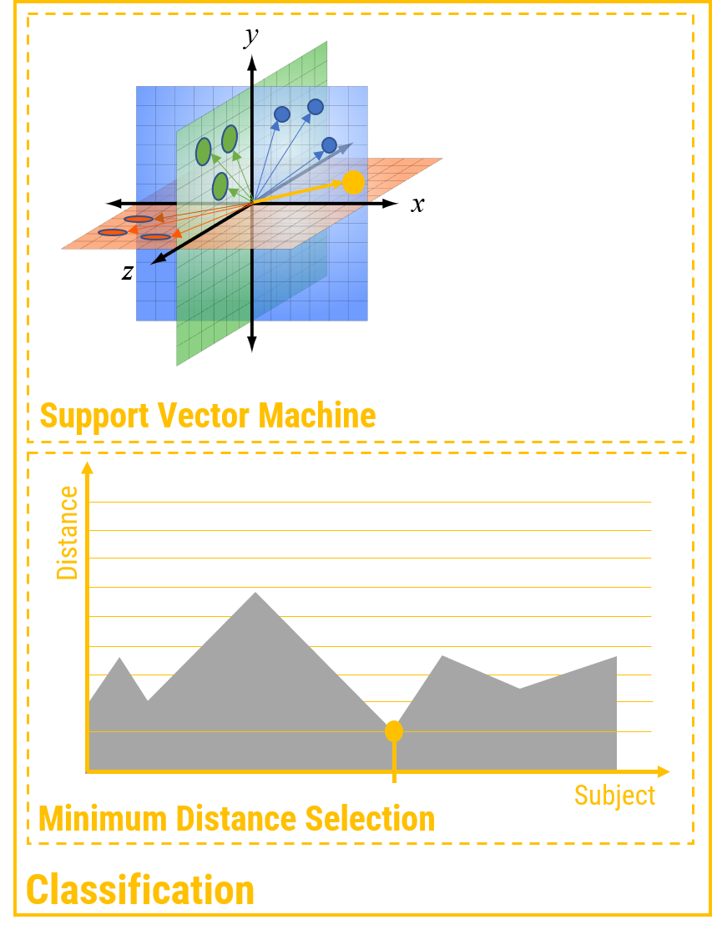
Face Recognition Pipeline
Image Input
User Lookup
Notes:
Here, you can see the overview of our facial recognition pipeline.
We capture an image from the camera and we run a simple object detection algorithm called Haar Cascade to determine the smallest rectangle that contains the face itself.
Haar Cascade uses a pre-defined feature set for object recognition. It tries to match features on the input image to this set as shown.
We crop the frame to this rectangle

Slide 12
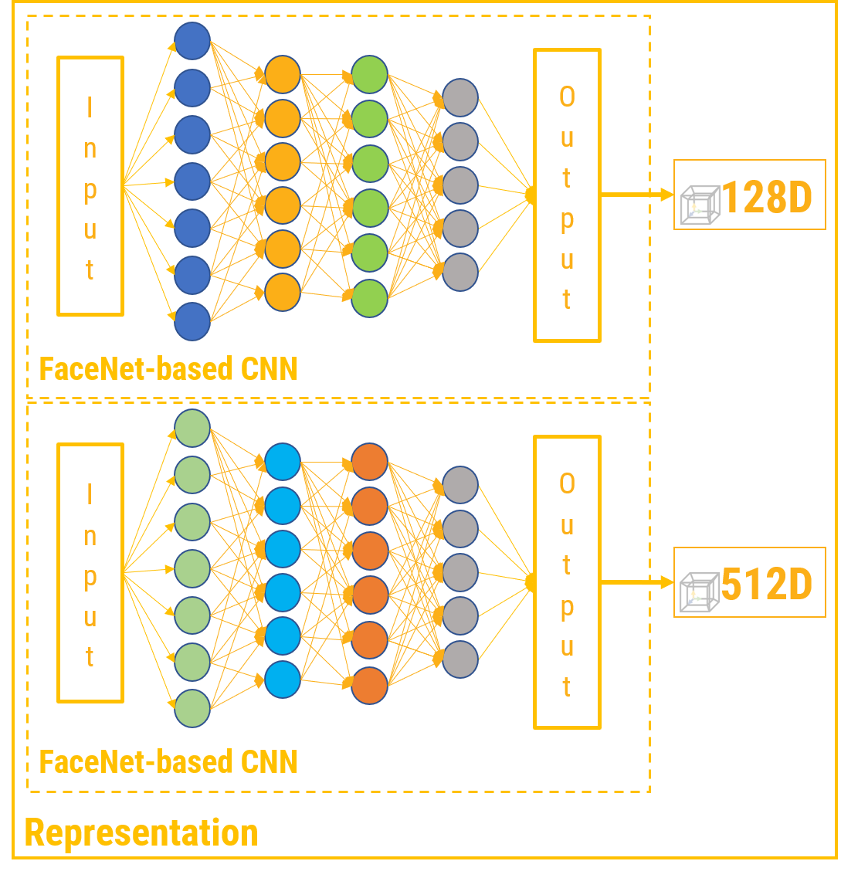
Face Recognition Pipeline
Image Input
User Lookup
Notes:
Here, you can see the overview of our facial recognition pipeline.
We capture an image from the camera and we run a simple object detection algorithm called Haar Cascade to determine the smallest rectangle that contains the face itself.
Haar Cascade uses a pre-defined feature set for object recognition. It tries to match features on the input image to this set as shown.
We crop the frame to this rectangle

Slide 13
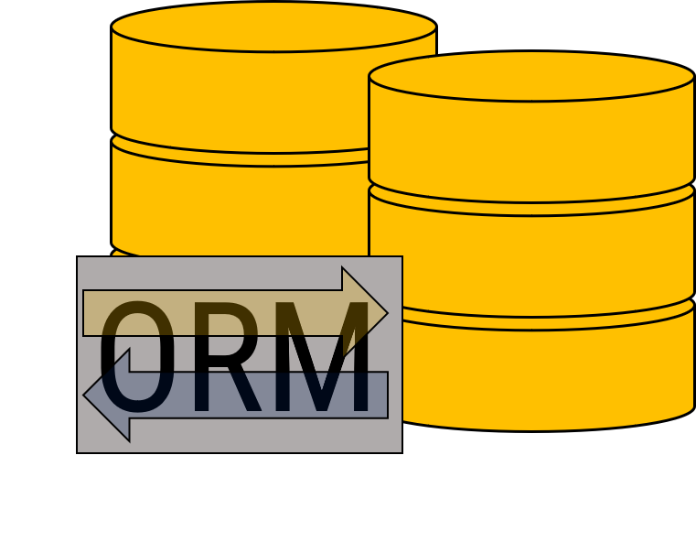
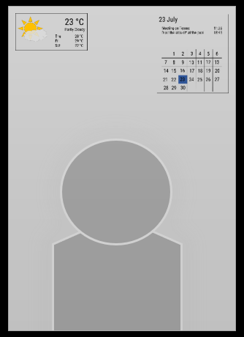
Database and Webserver
HTTP
Requests
And
Responses
Smart Mirror
Management
website

Slide 14
23 °C
Partly Cloudy
Thu 28 °C
Fri 29 °C
Sat 22 °C
23 July
Meeting on Teams 11:35
Drop the kids off at the pool 13:45
1
2
3
4
5
6
7
8
9
10
11
12
13
14
15
16
17
18
19
20
21
22
23
24
25
26
27
28
29
30

Slide 15
ORM

Slide 17
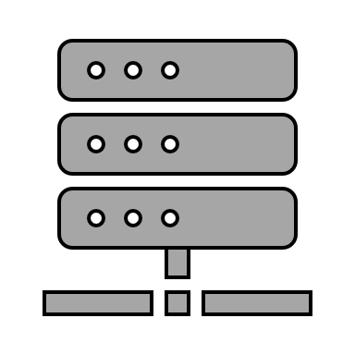

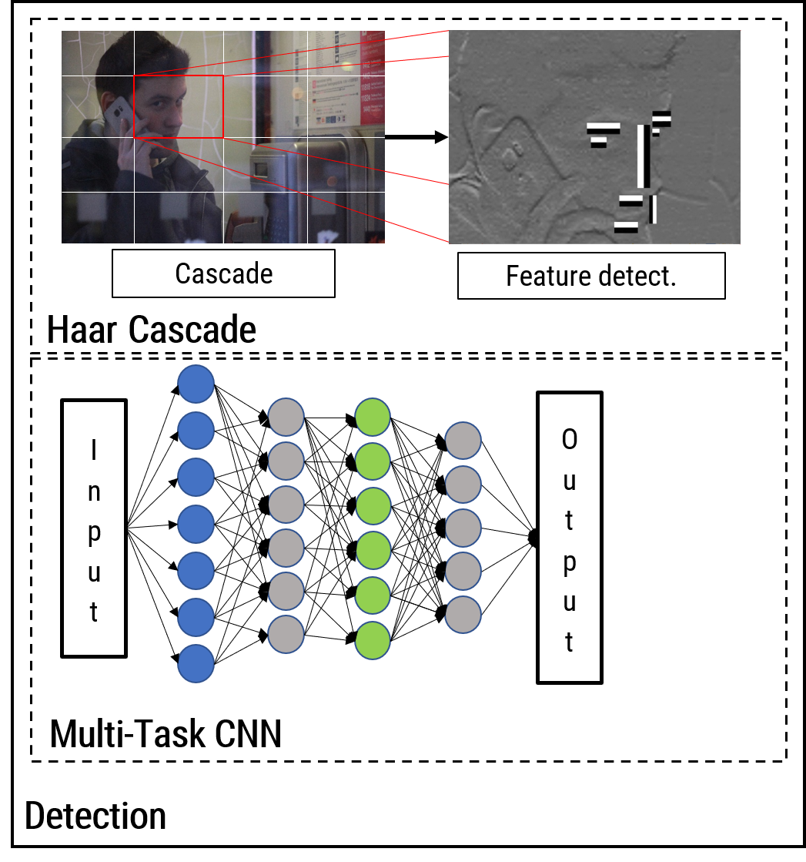
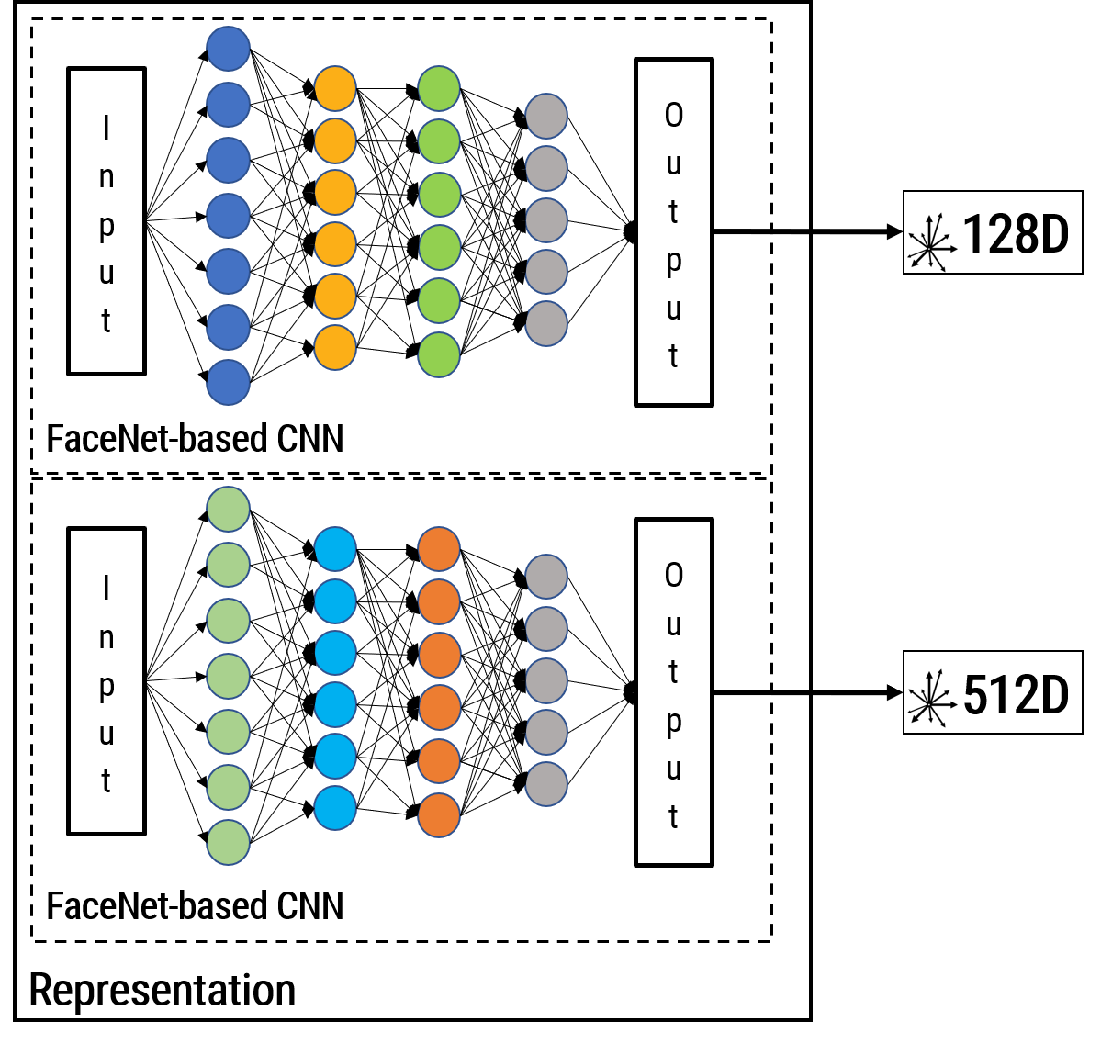
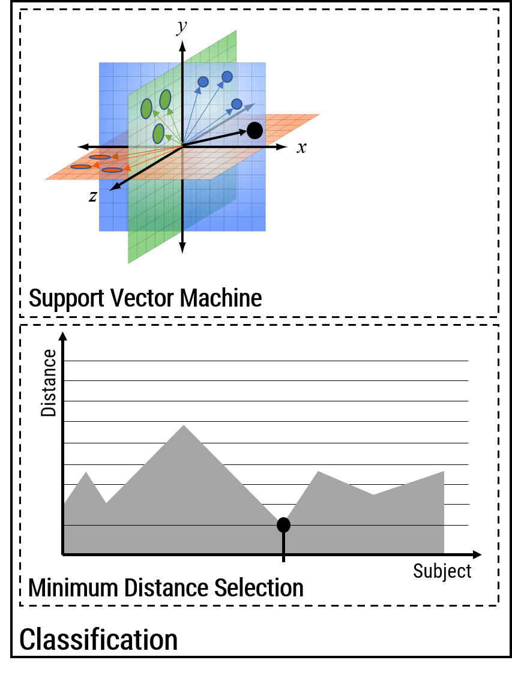
Face Recognition Pipeline
Image Input
User Lookup

Slide 18
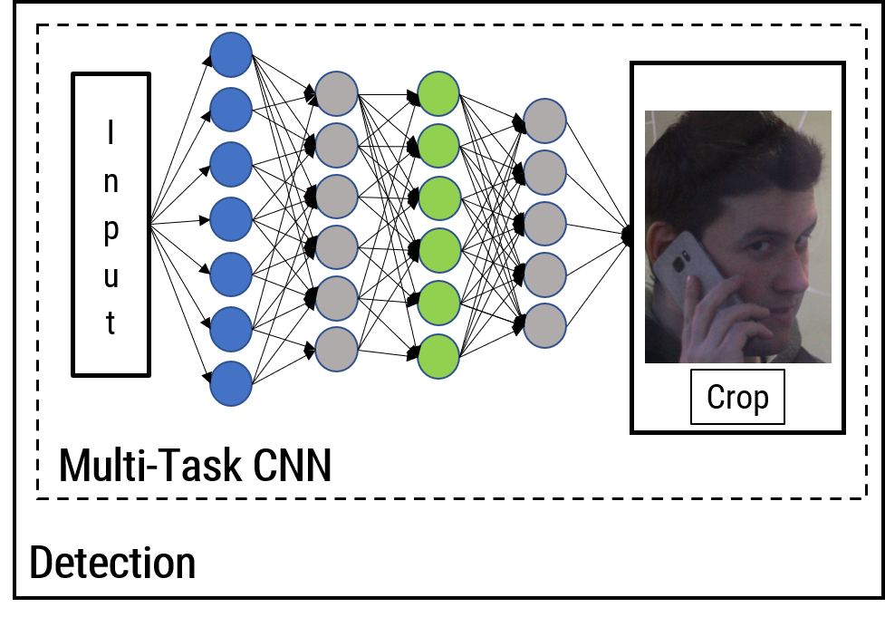
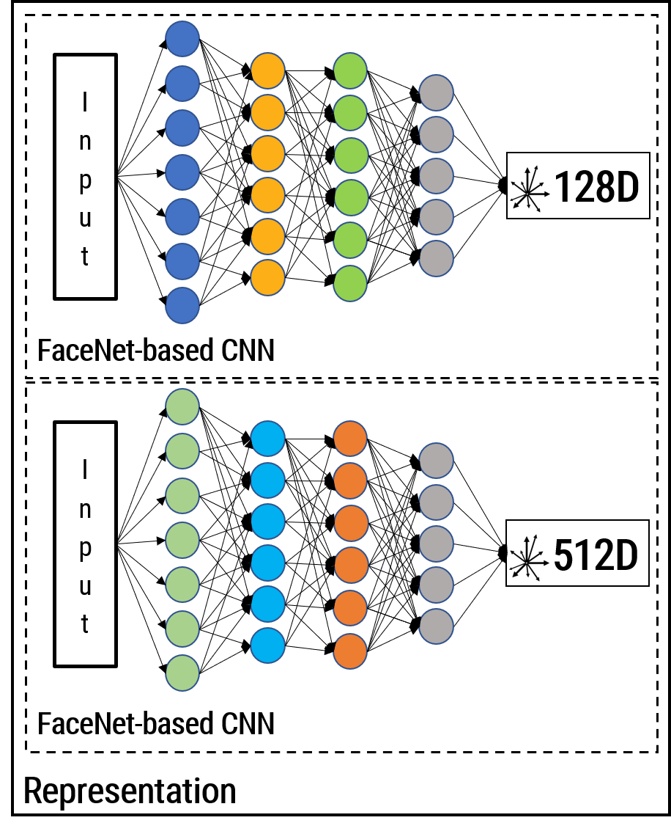
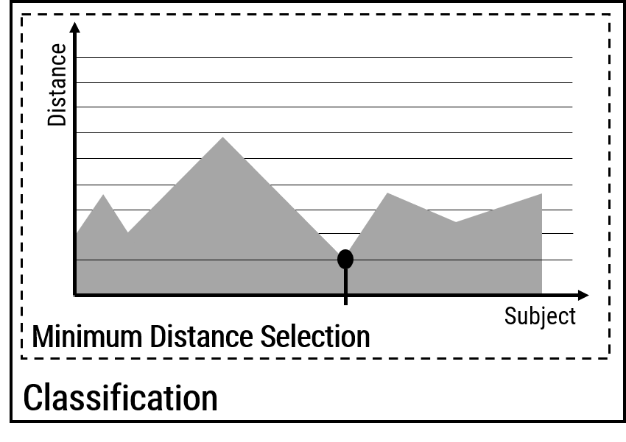
Image Input

